Slide 1
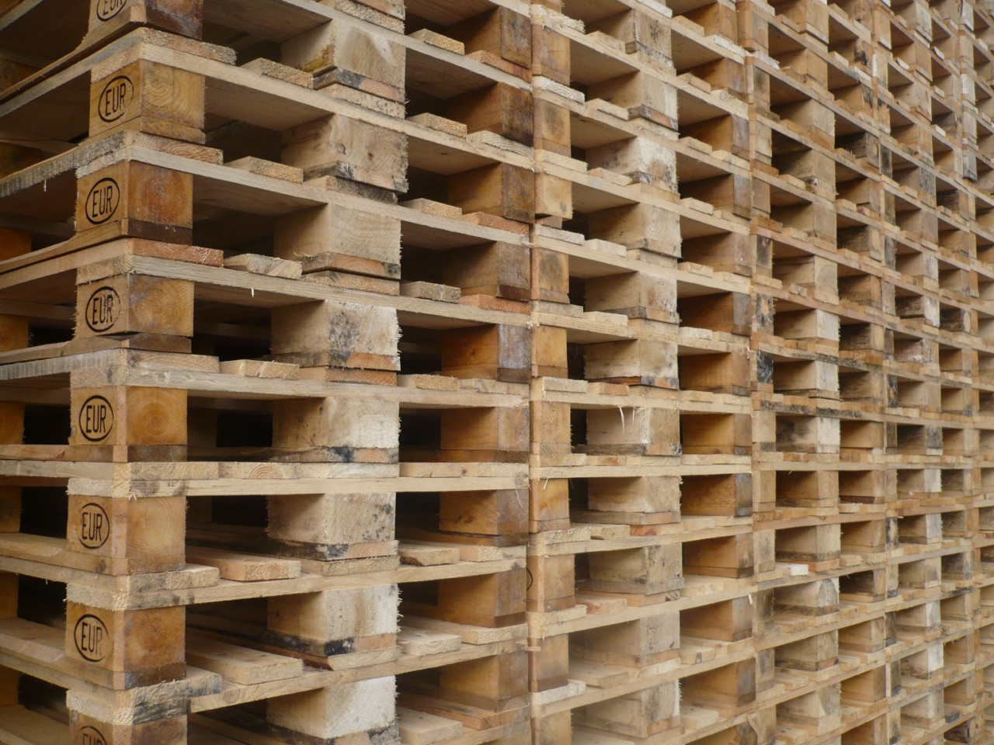
Loading Units

Slide 2
Loading units
Loading units are used to handle shipments (package units) on an easier and more simple way.
We will look at the following loading units:
Pallet
Trolley
Slip sheet
Big Bag / IBC Integrated Bulk Container
Notes:
Je gebruikt laad eenheden omdat je zo producten makkelijker kan laden en vervoeren.

Slide 3
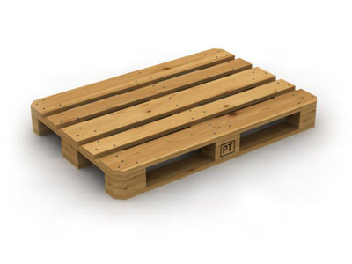
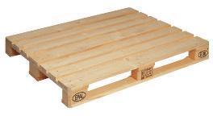
Pallet
Pallet is a flat transport structure that supports goods in a stable fashion
while being lifted by a forklift or pallet jack, front loader or other jacking
device. A pallet is the structural foundation which allows handling and
storage efficiencies. Goods are often placed on a pallet secured with
strapping, stretch wrap or shrink and shipped. While most pallets are
wooden, pallets also are made of plastic, metal and paper.
Each material has advantages and disadvantages relative to the others.
EUR1 pallet 120x80x15 ISO or NEN or EUR2 pallet 120x100x15
Notes:
Euro pallet 120 bij 80 iso nen pallet 120 bij 100

Slide 4
Conceptual point of view
From a conceptual point of view we have different kind of pallets:
EUR pallets
Pool pallets
Two-way and four-way pallets
One-way pallets
Export pallets

Slide 5
Conceptual point of view: EUR pallet
EUR pallets
are exchangeable
have a deposit of approx. euro 10,-- per pallet
have a stamp with EUR or EPAL on it
Will lose their value in case they are broken.

Slide 6
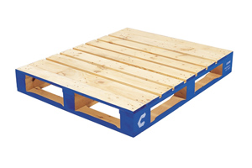
Conceptual point of view: POOL pallet
POOL pallets
are officially not exchangeable, but it happens now and then;
are rented, but the ownership belongs to the lessor
have a specific logo and color of the lessor
will not lose its value if broken.

Slide 7
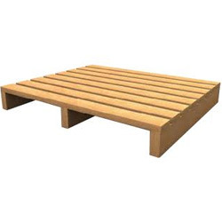
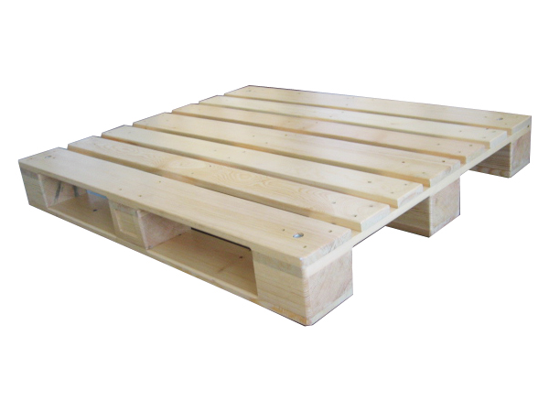
Conceptual point of view: 2- and 4-way pallet
2-way and 4-way pallets
2-way pallets can be handled from 2 sides;
4-way pallets can be handles from 4 sides;
4- way pallets are often more expensive .
4-way pallet 2-way pallet

Slide 8
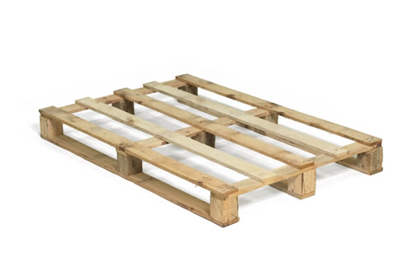
Conceptual point of view: 1-way
1-way pallet
don’t confuse them with the 2- and 4-way pallets !!!!
One-way pallets are sold together with the cargo;
One-way pallets are often made of inferior materials;
There is no reverse-logistics.

Slide 9

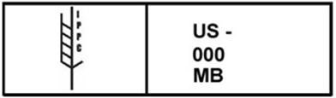
Export pallets: Phytosanitary Compliance
Due to the International Plant Protection Convention (IPPC) most export pallets must be made of materials that are incapable of being a carrier of invasive species of insects and plants diseases.
The standard for these pallets are specified in ISPM 15.
Pallets made of raw, untreated wood are not compliant with ISPM 15 and must be treated by:
heat treatment (56 ºC for >30 minutes) (stamp HT)
Chemical fumigation with methyl bromide (stamp MB)
Pallets made of non-wood material such as steel, aluminum, plastic or engineered wood products, such as plywood, oriented strand board, or corrugated fiberboard do not need IPPC approval.

Slide 10
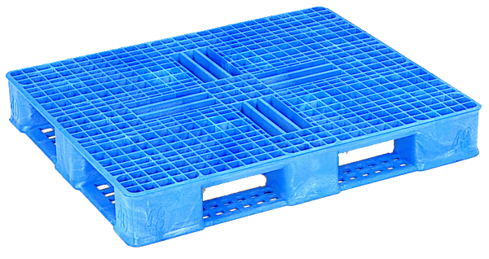
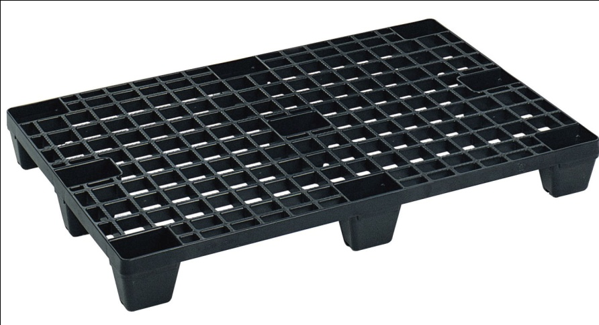
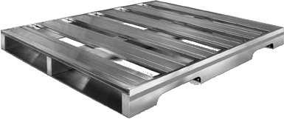
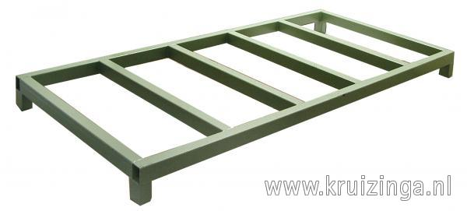
An answer to ISPM 15: different kind of export pallets
Plastic pallet (HDPE or recycled PET) plastic pallet
Aluminum pallet steel pallet

Slide 11
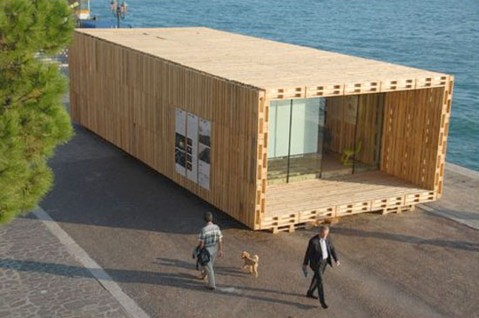
House made of pallets

Slide 12
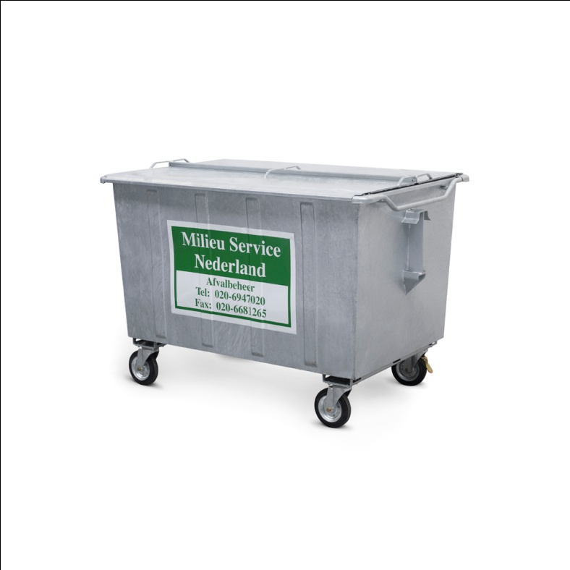
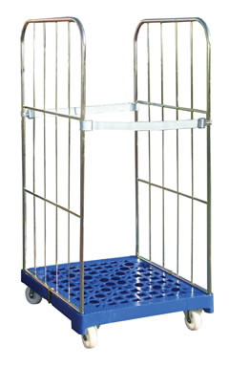
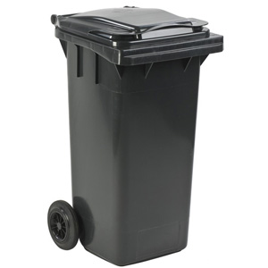
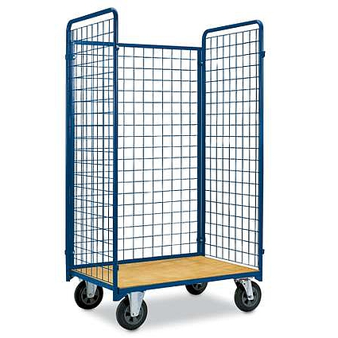
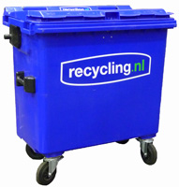
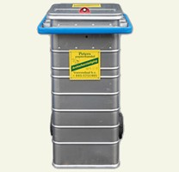
The Trolley – in general
Various sizes
Not standardized

Slide 13
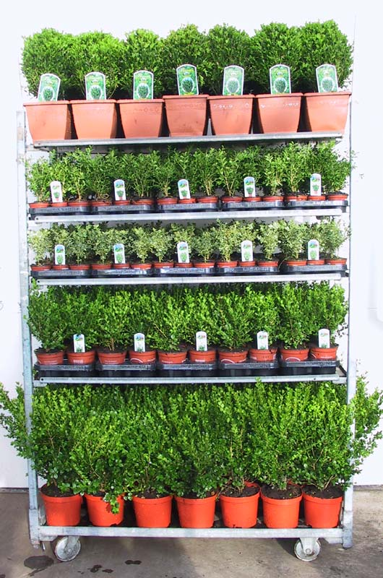
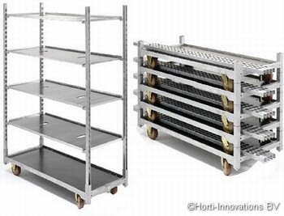
The Danish trolley
The most famous is the Danish trolley. A type of wheeled shelfing unit
to transport goods in horticulture.
The size is 135 x 56,5 x variable height cm.
Sizes of the Danish trolleys are standardized, but not compatible with transport units !!!!

Slide 14
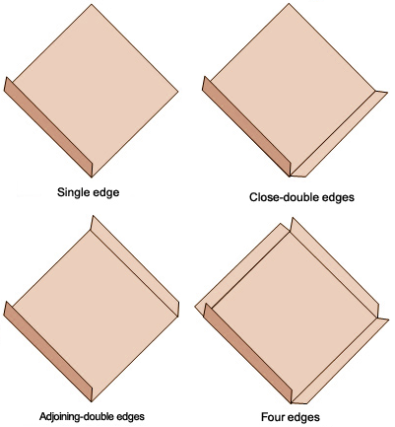
The slip sheet
Slip sheets are thin pallet-sized sheets.
It replaces often the use of pallets.
The cargo is usually stretch wrapped or shrink wrapped for stability.
The thickness of the slip sheet is approx. 1 cm.
Slip sheets can be equipped with:
single lip - for loading and unloading from one side
multi lip - for loading and unloading from several sides.
Notes:
Slip sheet houdt het glijden van een pallet tegen je heb 2 verschillende soorten slip sheets de single lip en de multi lip.

Slide 15
The slip sheet: material
Advantage disadvantage
Corrugated low cost not very durable
one-way use not moisture resistant
not resistant to high humidity
not usable in cold storage areas
Fiberboard or multiple uses medium costs
solid kraftboard ability to withstand humid not very durable
ability to withstand cold
Plastic multiple uses /long life high cost
ability to withstand humid
ability to withstand cold

Slide 16
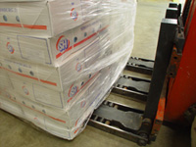
Slip sheet versus pallet
Slip sheet advantages:
you can load more product in a container;
slip sheets do not require maintenance and can be replaced easily;
significant reduction in material handling costs;
decreases loading/unloading time by up to 60% (when using rollerforks)
weight 1/20 of the weight of a wooden pallet;
can be customized to fit any size load;
eliminates the need for pallet exchange;
reusable and reliable;
most are recyclable ;
is cost-effective;
unlike wooden pallets slip sheets are not subject to phytosanitary restrictions.
Notes:
Slipsheet voordelen: je kan meer producten laden. Kan makkelijker vervangen worden.

Slide 17
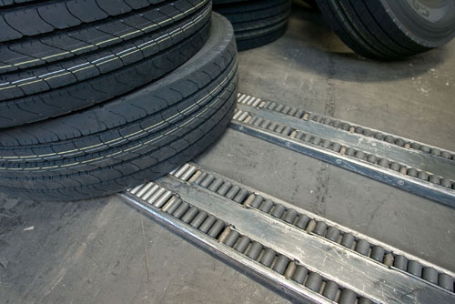
Slip sheet versus pallet
Slip sheet disadvantages:
pallets provide a greater clearance between the floor and the unit load;
slip sheet usage requires special devices on a fork lifter;
when used alone, pallets provide more structural support than slip sheets;
pallets are easily compatible with cranes;
fork lifters can handle less in case of using slip sheets;
slower handling, except when you use roller forks. (see below)

Slide 18
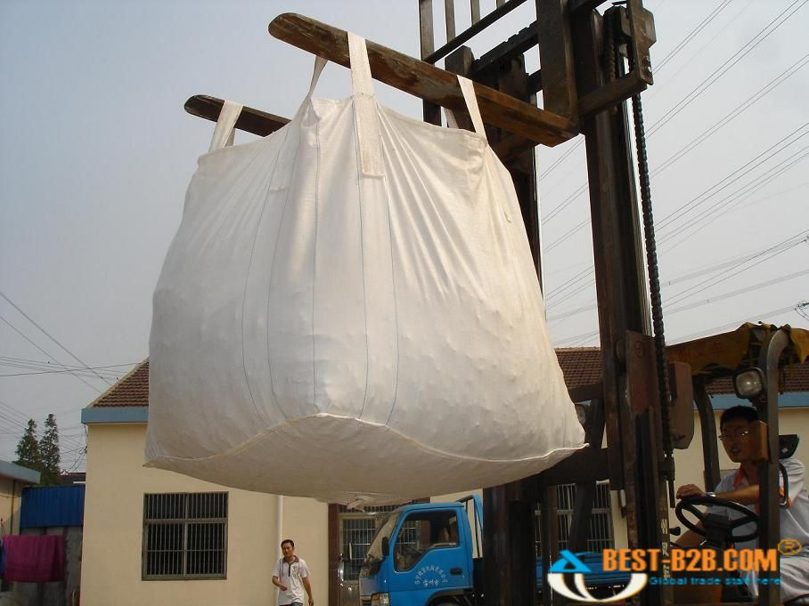
BigBag
Is a standardized container in large dimensions for storing and transporting dry, flow able products, for example sand, fertilizers, granulates and plastics.
Other names:
Flexible Intermediate Bulk Container (FIBC)
Big Bag
Big Sack
Super Sack
Made of woven polyethylene or polypropylene, coated or uncoated
Transporting and loading is done on either pallets or by lifting it from the loops.
Max. load up to 1500 kg s.
Notes:
Bigbag wordt voor grote goederen gebruikt zoals bulk max load 1500 kilo.

